Slide 1
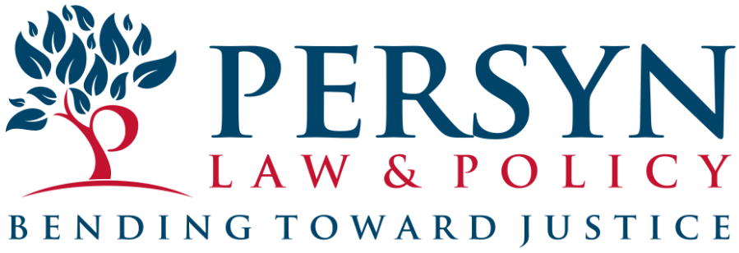
Kansas Judicial Branch
Office of Judicial Administration
Training Series: Impact of Child Toxic Stress
on the Juvenile Justice System
Session #5: Systemic Considerations: A Trauma-Informed Approach to Child Welfare and Juvenile Justice
November 16, 2023
Presented by Mary Kelly Persyn, J.D., Ph.D.

Slide 2
Agenda for today: Systemic Considerations: A Trauma-Informed Approach to Child Welfare and Juvenile Justice
Recap of Sessions #1 - #4; review of key concepts. (12:00 – 12:10)
What would trauma-informed child welfare and juvenile justice systems look like? (12:10 – 12:30)
What are positive childhood experiences and why do they matter? (12:30– 12:40)
What is Kansas currently doing to reform these systems? (12:40 – 12:45)
What lies ahead? (12:45 – 12:50)

Slide 3
Learning outcomes
Learners will be able to explain why systemic approaches are needed to better address child toxic stress and to reduce the tendency to compound it.
Learners will be able to list the basic principles of trauma-informed care and explain how these principles could be implemented in systems.
Learners will be able to define “Positive Childhood Experiences” (PCEs) and explain how they can counter toxic stress.
Learners will be able to discuss Kansas’ current approach to systems reform.

Slide 4
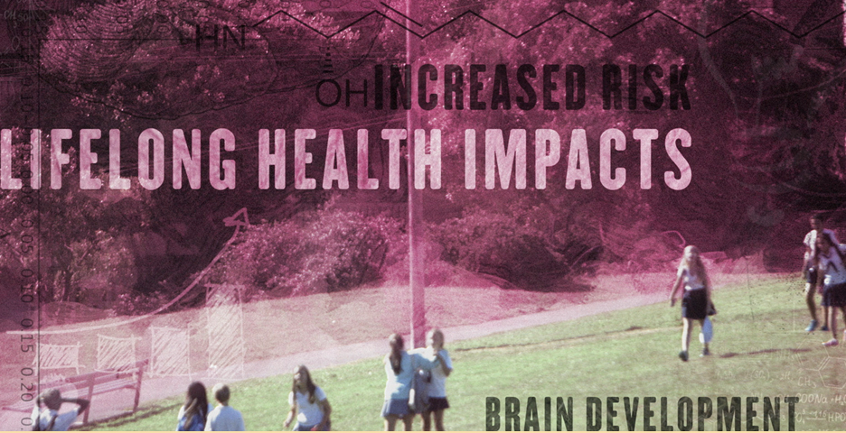
Part 1. Prior sessions recap and review
Basics of Child Trauma and Juvenile Justice System Involvement
Racial Trauma and the Juvenile Justice System
Child Toxic Stress and LGBTQ Identity/Discrimination
Child Toxic Stress and the Foster Care System

Slide 5
Welcome, and welcome back!
Thank you so much for choosing to spend an hour with me today thinking about how trauma-informed practice can impact the child welfare and juvenile justice systems. Throughout these sessions, we’ve thought broadly about toxic stress, and we’ll continue to do so today.
If you weren’t with us for any of the previous sessions, welcome! If you did join previously, welcome back.

Slide 6
Recap: Adverse Childhood Experiences, toxic stress, and system involvement
We talked about:
-The difference between adverse childhood experiences and toxic stress
-How and why the same experience is traumatic for some kids but not all
-What trauma reactions look like
-Why researchers have expanded the number and type of ACEs
-”Expanded ACEs”
Notes:
In Session #1, we took two hours to explore the basics of adverse childhood experiences, or ACEs, and toxic stress. The original ACEs study asked a cohort of adults to report which of 10 experiences they’d had before they turned 18, and then compared those scores to the adults’ health. The study found a dose-response relationship between adverse experiences and serious lifetime chronic health problems, including depression, suicidality, substance abuse, COPD, cancer, asthma, and more. As we discussed in November, ACEs scores are a retrospective, population-based risk measure. These surveys are very useful for public health, but not so useful for individual evaluation and diagnosis. Certainly no individual person should count up their ACE score and draw conclusions about their lifespan; ACE scores are best interpreted with your primary care doctor, if at all.
We also discussed how traumatic experiences and toxic stress impact brain function and development and can affect physical health. A child impacted by trauma and/or toxic stress is likely to be more reactive, self-protective, and defensive than a child who hasn’t had these experiences. The flight or fight response can bypass the brain regions that engage higher-level functions. The ensuing reactions and coping mechanisms can cause significant difficulties.
Finally, we discussed researchers who have expanded the concepts of ACEs and child toxic stress. While the original ACEs measured stressors within the four walls of the home, further research on “expanded ACEs” has identified other stressors as additional sources of significant adversity and toxic stress, including, for example, racism, food insecurity, housing insecurity, and community violence.

Slide 7
Disparities persist in Kansas
Notes:
As we discussed in previously, while SB 367 reduced the juvenile incarceration rate in Kansas, the racial disparity in that incarceration rate did not decrease—instead, the research tends to indicate that the disparity increased. In February, we talked about how and why race based toxic stress can be linked to juvenile justice system involvement.

Slide 8
How do RBTS and racism(s) impact the racially disparate rate of JJS involvement? What’s next?
Theories explaining racial disparity in juvenile justice system involvement are basically of two types: differential offending; differential treatment.
If we take a step back, we can think yet more deeply into the systems and interactions that shape, constrain, and direct our youth.
This lens can remake the way that we think about and support living wages, schooling, access to healthy food, childcare, and medical care—and yes—the juvenile justice system.
This is just the beginning of the story.
Notes:
Session 2
What we can understand and explain, we can prevent.
(Note, research suggests that differential treatment and support of Black and white children committing the same violation accounts for about 46% of the racial disparity in suspensions. See J. Owens and S. McLanahan in the Resources.)
“With a complex social problem such as racial and ethnic disparity, numerous factors are likely at work, including poverty, segregation, educational challenges, residential instability, and the broader “racialized society” in which many institutional practices, public policies, and cultural representations operate (National Research Council, 2013). Thus, racial/ethnic disparities are “not reducible to either differential offending or differential selection” (National Research Council, 2013).” OJJDP literature review, in the Resources.

Slide 9
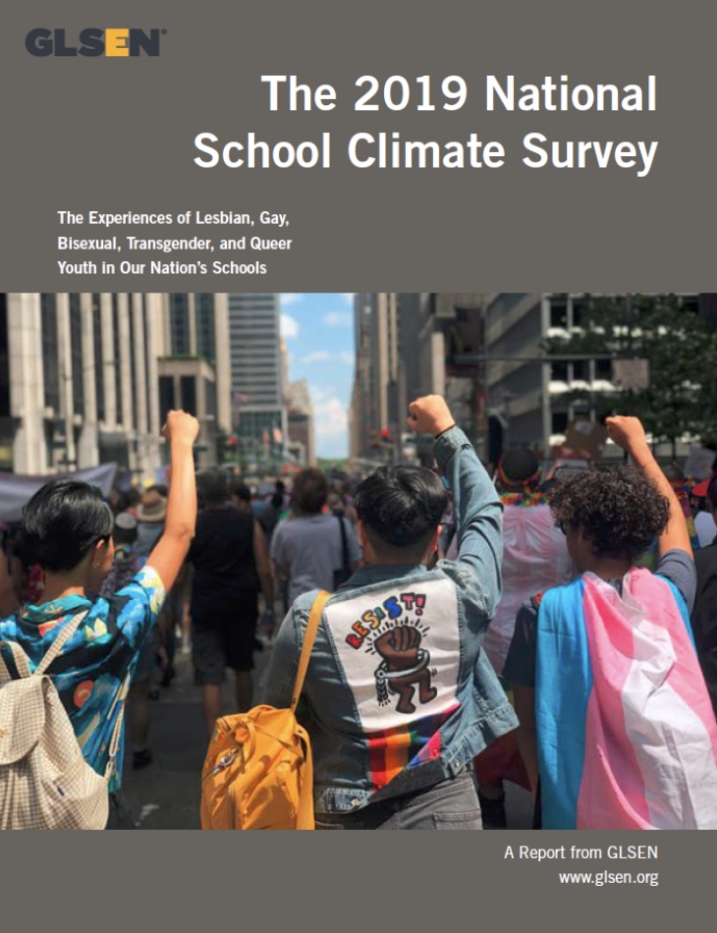
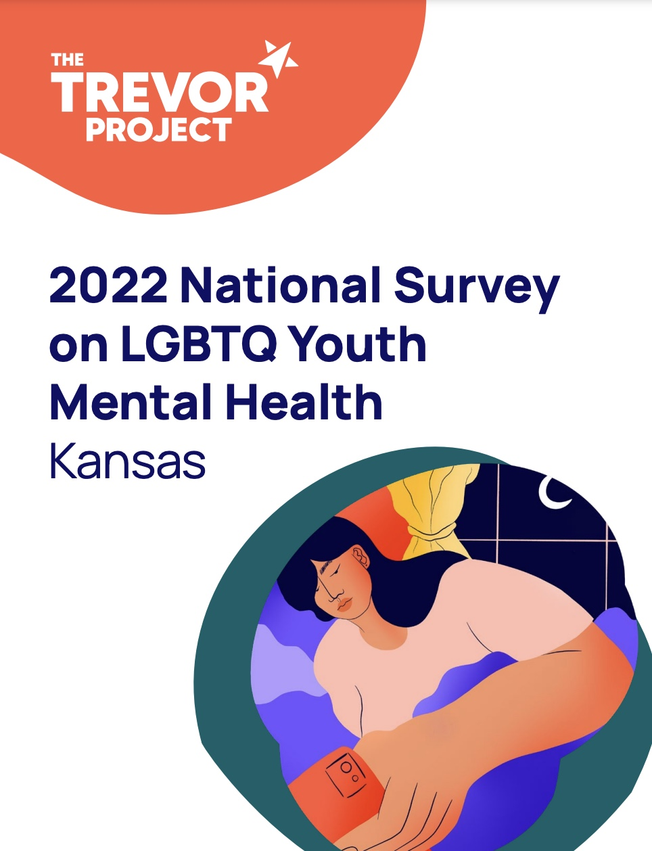
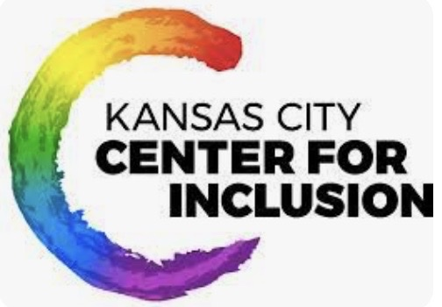
A snapshot of LGBTQ youth in Kansas
Kansas, a state of 2,935,000 people, has about 19,000 youth ages 13-17 who identify as LGBTQ.
The Trevor Project’s 2022 national survey of LGBTQ mental health breaks out data on these young Kansans.
As we’ll see, LGBTQ youth in Kansas struggle with discrimination and mental health challenges at a relatively high rate.
Notes:
Session 3.

Slide 10
Foster care system involvement can be a cause of toxic stress
Stressors involved with child removal and foster care placement are legion: family separation, changing schools, instability.
Stable relationships can buffer stress. But foster parents frequently lack the training needed to understand and intervene in trauma responses and the resulting behaviors.
This can result in foster kids having police called on them for relatively minor infractions.
Notes:
Session 4.

Slide 11
Placement instability is a bridge between systems
Notes:
Source to Teen Vogue series on foster care to prison pipeline
The 90% figure is not limited to involvement with the *juvenile* justice system. For example, 25% of youth in foster care will be involved with the criminal legal system within two years of leaving care.
Underlying references: Miriam Aroni Krinsky, Disrupting the Pathway from Foster Care to the Justice System—A Former Prosecutor’s Perspectives on Reform, 48 Fam. Ct. Rev. 322, 325 (2010), https://archive.constitutionproject.org/wp-content/uploads/2012/10/399.pdf (citing J.P. Ryan & M.F. Testa, Child Maltreatment and Juvenile Delinquency: Investigating the Role of Placement and Placement Instability, 27 Child & Youth Serv. Rev. 227, 230 (2005)).

Slide 12
Session #5 Quiz (pre-test)
As many as 92% of juvenile justice system-involved youth have experienced trauma and/or chronic toxic stress.
T
F
Once a child has experienced sufficient adversity and trauma, positive childhood experiences (PCEs) can no longer buffer the impact.
T
F

Slide 13
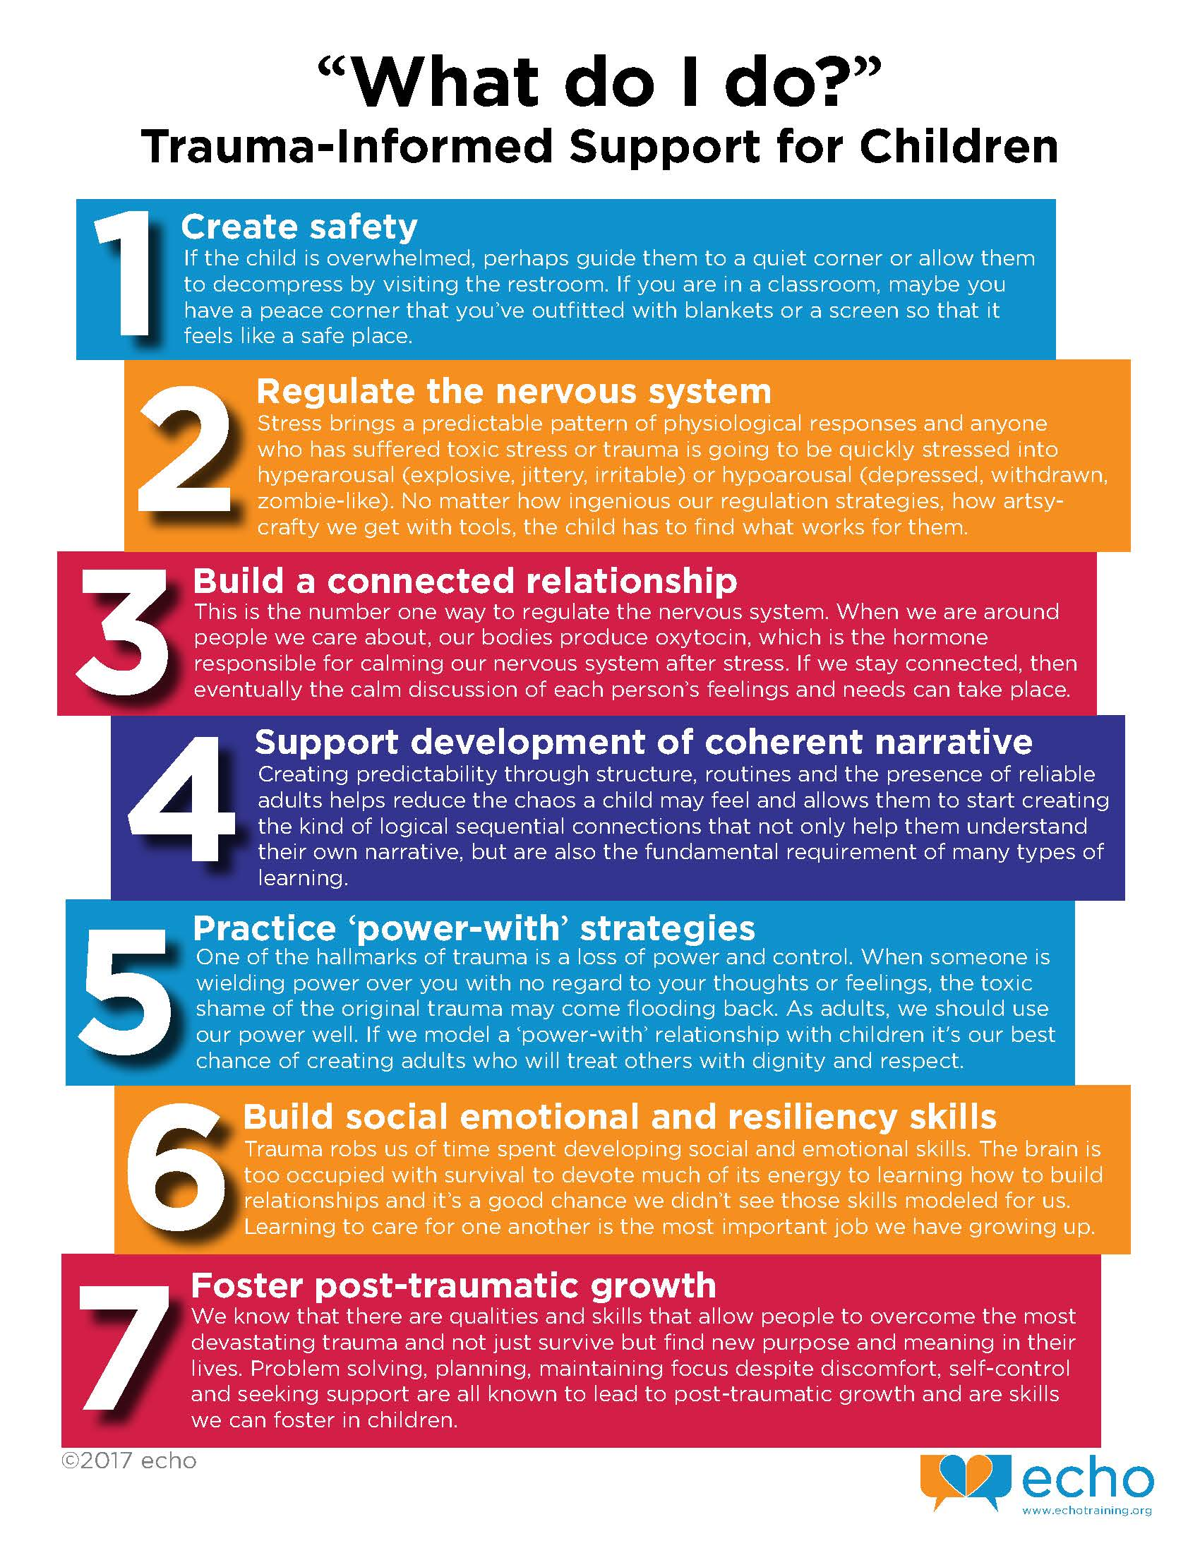
Part 2. Trauma-informed systems
According to the National Child Traumatic Stress Network, a trauma-informed child and family service system ”is one in which all parties involved recognize and respond to the impact of traumatic stress on those who have contact with the system including children, caregivers, and service providers.”
The hope is that trauma-informed systems can help children and families heal by responding to the impact of past and present trauma and toxic stress.
Notes:
NCTSN, What is a Trauma-Informed Child and Family Service System? (2016). https://www.nctsn.org/resources/what-trauma-informed-child-and-family-service-system.
ECHO, “What do I do?”: Trauma-Informed Support for Children (2017). https://www.echotraining.org/trauma-informed-support-for-children/.

Slide 14
One million children, every year
NCTSN recognizes that many of these children “are victims of abuse or neglect, live with caregivers who are impaired, and/or deal with school and community violence as a fact of life.” (Gun violence is now the leading cause of death of children aged 1-18.) NCTSN’s website has a host of materials and tools to help systems and individuals respond.
Notes:
In any given year, ”about one million children come to the attention of the child welfare system.” (NCTSN)
https://www.nctsn.org/trauma-informed-care/creating-trauma-informed-systems/child-welfare

Slide 15
NCTSN Essential Elements of a Trauma-Informed Juvenile Justice System
Why is trauma-informed care essential? Because “more than 80% of juvenile justice-involved youth report experiencing trauma, with many having experienced multiple, chronic, and pervasive interpersonal traumas.” (NCTSN)
Notes:
https://www.nctsn.org/trauma-informed-care/trauma-informed-systems/justice/essential-elements
Guide available at https://www.nctsn.org/sites/default/files/resources//essential_elements_trauma_informed_juvenile_justice_system.pdf

Slide 16
The North Star: safety
Notes:
Juvenile justice policies and procedures are trauma-informed when they establish—at every level in the organization—a culture that recognizes the adverse effects of trauma on youth, families, and staff; requires and supports operational practices that consistently prevent further traumatization; and supports healing and recovery of all trauma-affected individuals in the organization.

Slide 17
Why is safety such an important factor?
Between 70% and 92% of youth with delinquencies have experienced past trauma
In one body of research, 32% of delinquent youth met the criteria for PTSD (3% in overall child population)
Youth experiencing chronic trauma shift emotional states rapidly, cannot calm themselves (self-regulate), and develop negative self-perceptions
Opposition and disrespect for authority among these youth are survival responses that help youth feel safe and in control when experiencing overwhelming traumatic stress
BUT, this dysregulation puts them at much higher risk of excessive, harsh punishments; isolation; and rejection (self-reinforcing spiral)
Notes:
Safety is a key factor because toxic stress and trauma play such a significant role in the past lives of youth with delinquencies.
Jerel M. Ezell et al., Implementing Trauma-Informed Practice in Juvenile Justice Systems: What can Courts Learn from Child Welfare Interventions? J Child & Adolescent Trauma 11:507-519 (2018).

Slide 18
What does safety look like in practice?
Notes:
Office for Victims of Crime, Children, Violence, and Trauma—Innovations in Juvenile Justice (2014). https://www.youtube.com/watch?v=tbmwq0HzgC8

Slide 19
Example: the impact of placement instability
Notes:
On the left is a graphic we’ve seen before in this series, indicating that 90% of youth with five or more foster care placements will enter the juvenile justice system. That is a stark reminder of the importance of safety to an already-traumatized youth.
Graphic: UC Davis, SAMHSA PC-Care (2016) https://pcit.ucdavis.edu/samhsa-pccare/

Slide 20
Part 3. What are Positive Childhood Experiences?
Adverse Childhood Experiences are traumatic events that happen before a child reaches the age of 18.
Positive Childhood Experiences are experiences during childhood that promote safe, stable, and nurturing relationships and environments.
Families have a central role to play, but other adults are also sources of PCEs.
Notes:
CDC definitions.
Graphics: ACEs Aware; Lindsey Braman (paid download for group use)

Slide 21
Positive Childhood Experiences
Notes:
https://www.youtube.com/watch?v=ssDBIg2ih2Y

Slide 22
Buffering ACEs
The Centers for Disease Control and Prevention (CDC) has issued recommendations on community-based approaches to Positive Childhood Experiences (PCEs).
These actions strengthen and support families, protect children from violence, and help set them up for a safe, stable, and productive future.
PCEs also buffer ACEs. Kids in tough circumstances can benefit significantly from them.
Notes:
Centers for Disease Control and Prevention, Teen Newsletter: Adverse Childhood Experiences (ACEs) (March 2023). https://www.cdc.gov/museum/education/newsletter/2023/mar/index.html

Slide 23
The STRENGTH Framework for Child Welfare and Juvenile Justice
STRENGTH is an acronym:
Systems integration
Trustworthy and safe
Relationships
Equity, inclusion, and belonging
Needs met holistically
Growth, leadership and opportunities to fail and learn
Training and education
Healing
Notes:
The STRENGTH framework combines positive youth development, racial equity, and community belonging. The framework is the product of a collaboration between Annie E. Casey Foundation, the nonprofit research center Child Trends, and Child Focus. The framework emphasizes cooperation between the sectors that serve youth. As one of the reporters noted, “these systems limit youth ability to connect to others within their family and community and develop a sense of belonging, while simultaneously forcing independence on them without providing the healing and long-lasting relationships they need.” We can’t expect to succeed in rehabilitating youth when we separate them from family and community without ensuring stability and relationships. The STRENGTH framework lists the factors needed within these contexts.
Safety, stability, and relationships again come to the fore. And you can see how aligned the STRENGTH framework is with the seven positive childhood experiences that research has demonstrated can buffer the impact of ACEs.

Slide 24
Part 4. A snapshot of trauma-informed systems reform in Kansas
SB 367 and its implementation, the Kansas Family First Prevention Services Act, and continuing implementation of the crossover youth practice model in Kansas are three examples of reforms in progress.
Notes:
These projects may not explicitly identify as trauma-informed, but they share many key characteristics.

Slide 25
S.B. 367
Accomplishments:
Between FY2015 and 2020, the annual average number of youth entering the juvenile justice system fell more than 24%.
Average number of youth in custody fell 88% between FY2015 and 2020.
Obstacles and difficulties:
As of 2019, Black youth in Kansas were incarcerated at 5 times the rate of white youth, and Latino/a youth at 1.4 times the rate of white youth.
Money saved when fewer youth were incarcerated went to general savings, rather than funding needed services for youth.
Notes:
SB 367 is a major effort to reduce youth incarceration in Kansas. When 367 was originally enacted in 2016, Kansas incarcerated more youth than almost every other state. Only 24% of incarcerated youth were assessed as “high 367 risk” offenders, and 23% of these youth were incarcerated for technical violations. Youth released from juvenile correction facilities had high recidivism rates and the communities to which they returned had few resources for them.
367 solved some problems while creating others. Evidence tends to indicate that there are too few resources to fund community supervision or treatment plans for juvenile offenders, and the probation programs that substitute for them are inadequate and don’t hold youth accountable. Further, according to KVC Kansas, foster care providers now have to deal directly with juvenile delinquency. More crisis intervention centers and community mental health treatment would help, and Kansas has set aside money for this purpose, but as of January hadn’t used any of it yet.

Slide 26
Kansas Family First Prevention Services Act
The FFPSA , a federal law, was enacted as part of Public Law 115-123. It authorized new optional Title IV-E funding for time-limited prevention services for mental health, substance abuse, and parent skill-based programs to benefit children or youth who are at risk of foster care and their parents or caregivers. Kansas is the recipient of a federal FFPSA grant.

Slide 27
Crossover Youth Practice Model
Notes:
Graphic: Georgetown University Center for Juvenile Justice Reform, What is the CYPM? https://cjjr.georgetown.edu/our-work/crossover-youth-practice-model/what-is-the-cypm/

Slide 28
The CYPM Team in Kansas
Goals of the Kansas Crossover State Policy Team:
Information Sharing and Data Collection
Prevention
Service Quality and Accessibility
Notes:
Graphic: Kansas state informational PDF on the CYPM collaborative (2021). https://www.doc.ks.gov/juvenile-services/crossover-youth-practice-model/cypm-kansas-flyer-08.2021

Slide 29
Part 5. What’s next?
Current and upcoming opportunities to learn more and get involved in supporting a more trauma-informed Kansas.

Slide 30
Coming up in Kansas and elsewhere
Continuing education
Projects and events
The National Child Traumatic Stress Network has a library of training materials available, including webinars and e-learning courses.
ACEs Aware hosts webinars and educational events about toxic stress.
The Bolch Judicial Institute at Duke Law has an educational program for state court judges and administrators about toxic stress and the juvenile justice system (part of the trauma-informed courts movement).
Kansas State Child Welfare Summit, April 15-16, 2024
Creating Trauma-Sensitive Schools Conference, February 19-23, 2024 (Dallas, TX)

Slide 31
Session #5 Quiz, Reprise
As many as 92% of juvenile justice system-involved youth have experienced trauma and/or chronic toxic stress.
T
F
Once a child has experienced sufficient adversity and trauma, positive childhood experiences (PCEs) can no longer buffer the impact.
T
F

Slide 32
Conclusion: what is the impact of child toxic stress on the juvenile justice system?
Notes:
Over these five sessions, here are two of the graphics that stick with me the most when I think about this question: on the left, a graphic illustrating toxic stress wear and tear likened to an engine that never stops revving; and on the right, a graphic focused on disproportionality in the crossover youth population—some of the most vulnerable children of all--which also signals disparity within the child welfare system.
Toxic stress is a significant risk factor for juvenile justice system involvement. It is likely the most significant one.
We can and should add and strengthen interventions that help youth placed in foster care (and their foster parents), and we should do the same for juvenile justice system-involved youth. The North Star has to be safety, broadly defined as physical, mental, emotional, and psychological safety, paired with at least one secure and stable relationship with a trusted adult.
But think what a difference it would make to go to the root by ensuring that families have support before getting involved with the child welfare or juvenile justice systems. What does safety mean? For one thing, mitigating poverty, which is significantly correlated to child abuse and maltreatment—and thinking about how toxic stress works, you can see why. We can bolster social and emotional programs and support in schools, including more counselors. We can make schools safe for all kids, regardless of race, ethnicity, religion, or LGBTQ identity, by reducing all forms of discrimination.
I think about toxic stress like lead in the water. Low-income minority communities and households are at greatest risk, but it can and does affect everyone. Centering those most impacted by that lead, how can we filter it out of our water and make communities safer for us all?

Slide 33
Questions?

